Slide 1
PROJECT TITLE
REAP BIG IN THE SKY!
DIVE INTO AVIATION!!!!

Slide 2
OVERVIEW/OUTLINE OF THE PROJECT
In this project I seek to solve a business stakeholder problem who has been in aviation business but wants to expand it.
The main task is to help the head of aviation department on choice of aircraft to buy.
The aircraft should be safe and less risky to the company as well as well as its customers.

Slide 3
Business understanding
Your company is expanding in to new industries to diversify its portfolio. Specifically, they are interested in purchasing and operating airplanes for commercial and private enterprises, but do not know anything about the potential risks of aircraft. I have been charged with determining which aircraft are the lowest risk for the company to start this new business endeavour. To then translate my findings into actionable insights that the head of the new aviation division can use to help decide which aircraft to purchase.

Slide 4
DATA UNDERSTANDING
the data used for this project was from the aviation department.it containedinformation on fatalities incurred whether fatal or non fatal for different states in the us and other counries.I chose to use the data for mexico.the data contained the following:
sum of number by engine type
sum of total minor injuries.
purpose of flight
count of event by country.
broad phase of the flight.
total uninjured.
Aircraft damage.
weather condition.
Air carrier.
Aircraft category.

Slide 5
OBJECTIVES/GOALS
the objectives for this project was to advise an expanding company on choice of plane to buy to expand their business.
which aircraft are the lowest rik for the company to start the business endeavour.
which engine type has more fatal/nonfatal injuries.
which seasons are likely to have more accidents
which engine type has higher uninjured related accidents..

Slide 6
METHODOLOGY
The data cleaning was done after extracting the data for Mexico from aviation data.the first step was checking through the columns to se whether there are are outliers in the data.the uniformity of the data check revealed the data was skewed to the right.some values were not making sense in the the data .this prompted for dropping them,because they consisted close to ninety percent of the data set for Mexico.
Checking unique values,null values and logical consistency.
Dropping irrelevant columns;id.
Checking data uniformity.
Imputing using the median and Q3.
Checking categorical columns.
Checking duplicates.(none).
Checking for outliers.
Convert names in ‘make’ to lower case
Saving the clean data.
Connect clean data to tableau.
Data visualization,drawing insights and recommendatios.
Conclusion

Slide 7
DATA CLEANING REPORT
The data cleaning was done after extracting the data for Mexico from aviation data.the first step was checking through the columns to se whether there are are outliers in the data.the uniformity of the data check revealed the data was skewed to the right.some values were not making sense in the the data .this prompted for dropping them,because they consisted close to ninety percent of the data set for Mexico.

Slide 8
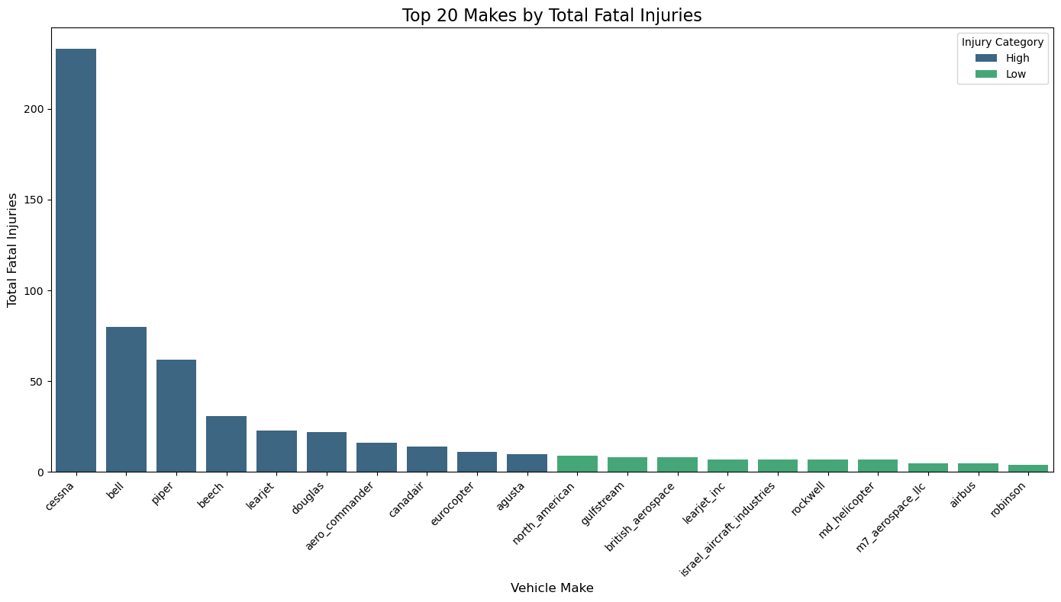
VISUAL ONE

Slide 9
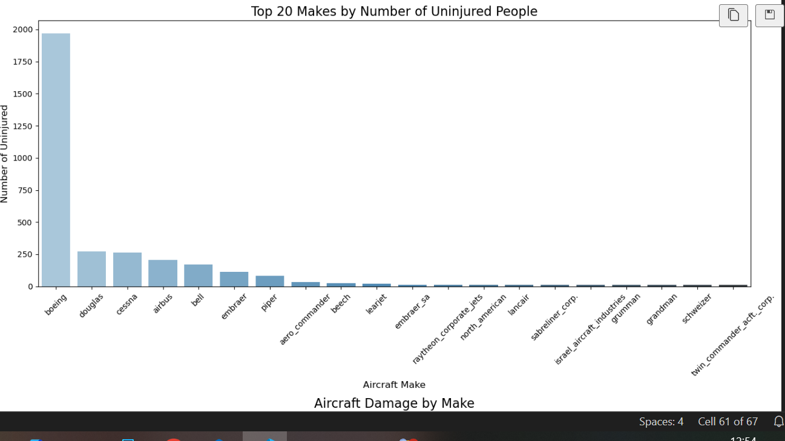
VISUAL TWO

Slide 10
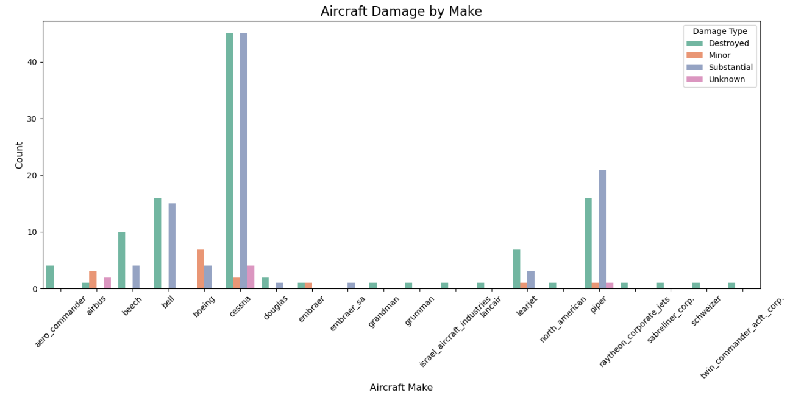
Visual three

Slide 11
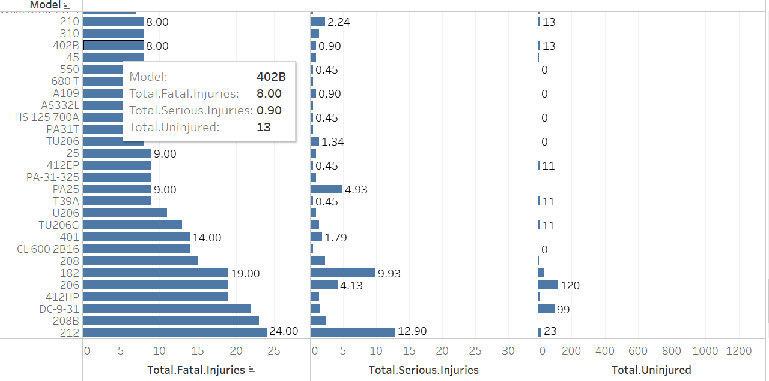
Visual four

Slide 12
RESULTS
From visual one when the top 20 makes by fatal injuries was plotted it is clear Cessna registered the highest number of total fatal injuries followed by bell then piper.
From visual two the top 2o makes versus number of uninjured persons placed boeing to have the highest count,followed by doughlas ‘make’.
From visual three of damage type its clear that when involved in an accident Cessna aircraft make was substantially destroyed while boeing incurred minor damage type registering the highest count on minor damages.
From visual 3 its clear that the 402 model is a comparatively best model.with lesser total fatal injuries of 8.00 and comparatively lower total serious injuries of 0.9 corresponding to 13 uninjured.

Slide 13
RECCOMMENDATIONS
Its clear that Cessna make was the most dangerous because it registered the highest number of fatalities while boeing was not even captured in the top 20 fatal injuries.
Boeing was the safest it is because when it was involved in an accident most of its passengers were uninjured as seen in visual two.
Boeing whenever involved in an accident was not destroyed as seen in visual three.it only got minor or substantial damages.
From this project I would recommend the business stakeholders of the company to consider investing in the boeing make.

Slide 14
ACKNOWLEDGEMENT
My appreciation goes our Technical mentor: Mr.wiliam Onkomba,for continuously instructing us on how to go about the project.
My group members for the constant critique of the steps and the tech knowhow skills.
Finally to the audience for giving me your time and listening to me.

Slide 15
CONTACT INFORMATION
PHONENO:0708376377
TWITTER:catherine/kips
FACEBOOK:catherine kiptui
EMAIL:catherinekiptui@gmail.com

Slide 16
CONCLUSION
From the findings I can conclude that the boeing make and 402’model’ is the best aircraft make fitted with security feature as well as safety features and its worth investing in for the best business adventures .
Im certain that these insights would go along way to have an impact on the business ;In future think of partnering with me for further insightful analysis for impactful data driven strategies bridging the gap between numbers and meaningful decisions.

Slide 17
QUESTIONS
TIME FOR QUESTIONS:

